Slide 1
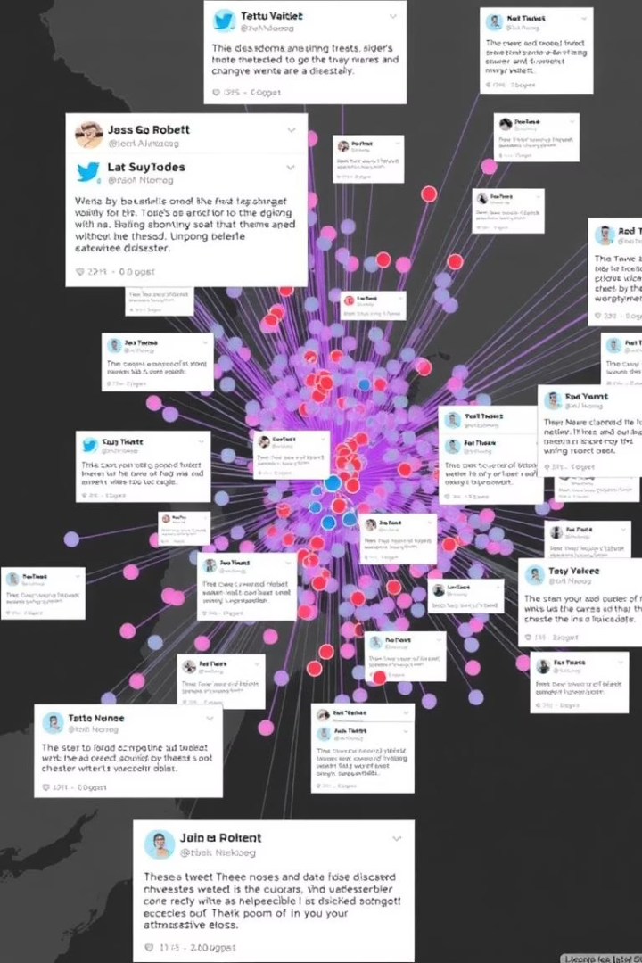

NLP Project for
Disaster Tweet Classification
In this project, I built a Tweet Classification Model to detect whether a tweet is related to a disaster or not. I started by cleaning the text—removing URLs, special characters, digits, and stopwords, and applied lemmatization to standardize the words.
I engineered additional features like sentiment polarity (using TextBlob), tweet length, hashtag count, and mention presence. These were combined with TF-IDF vectors to form the final input for the model.
I experimented with several machine learning algorithms and finalized Logistic Regression based on its accuracy and interpretability. After training, I created a real-time prediction system that takes user input, processes it, and classifies the tweet with a confidence score.
To make the model more accessible, I deployed it using Streamlit, building an interactive web app where users can test the model, explore example tweets, and download results as a CSV.
This project brought together NLP, feature engineering, machine learning, real-time prediction, and deployment to deliver a complete end-to-end tweet classification solution.
by Debasis Baidya

Slide 2







Contributions of Key Libraries & Modules to the Project
1
2
3
4
5
Pandas & Numpy
re, NLTK & TextBlob
Matplotlib, Seaborn & WordCloud
Scikit-learn (sklearn)
Scipy.sparse
I used these for loading, cleaning, and manipulating structured data and handling numerical computations.
I used these for cleaning tweet text, removing stopwords, lemmatizing, and calculating sentiment polarity.
I used these for visualizing EDA insights like class distribution, word frequencies, and generating word clouds.
I used this for TF-IDF vectorization, building ML models, evaluating performance using accuracy, F1-score, & confusion matrix.
I used this for combining sparse TF-IDF features with engineered features like sentiment score, tweet length, and hashtag count.
📊
🤖
6
7
8
9
10
Tqdm & Collections
FEE!
Transformers (Hugging Face)
Joblib & Pickle
OS & IPython.display
Streamlit
I used these for saving and loading trained models and vectorizers for real-time prediction.
I used these for monitoring loop progress and analyzing frequency of tokens and hashtags.
I used these for handling files/directories & improving output readability in the notebook.
I used this to build and deploy an interactive web app for real-time tweet classification.
I used this optionally to compare traditional models with state-of-the-art deep learning models.
🧩

Slide 3
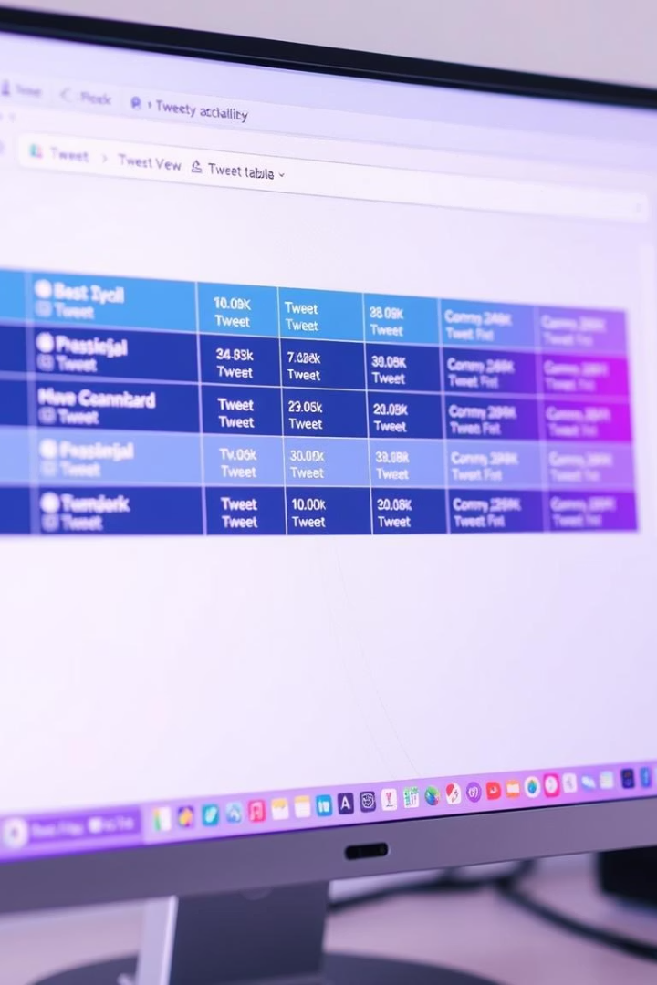
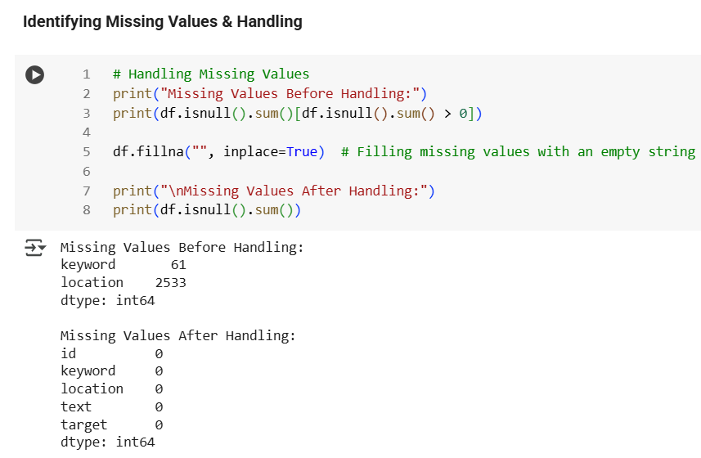
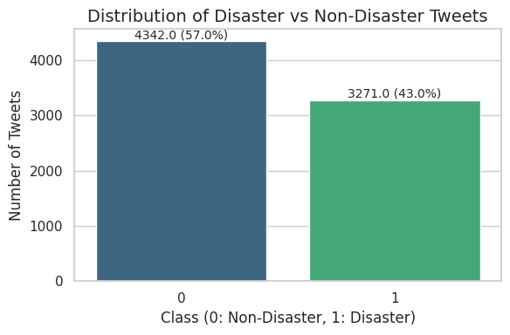
Dataset Overview
📂 Dataset Overview
Loaded dataset with 7,613 rows and 5 columns: `id`, `keyword`, `location`, `text`, `target`
Used `df.head()` to preview top 10 rows
🏗️ Data Types & Memory Usage
`id` and `target`: Integer
`keyword`, `location`, `text`: Object
Missing values found in `keyword` and `location`
⚠️ Handling Missing Values
`keyword`: 61 missing values
`location`: 2,533 missing values
Filled missing entries with empty string `""`
After handling: No missing values remained
📊 Disaster vs. Non-Disaster Distribution
Created bar plot using **Seaborn + Matplotlib**
57% Non-Disaster Tweets (4,342)
43% Disaster Tweets (3,271)
Slight imbalance, manageable without resampling

Slide 4
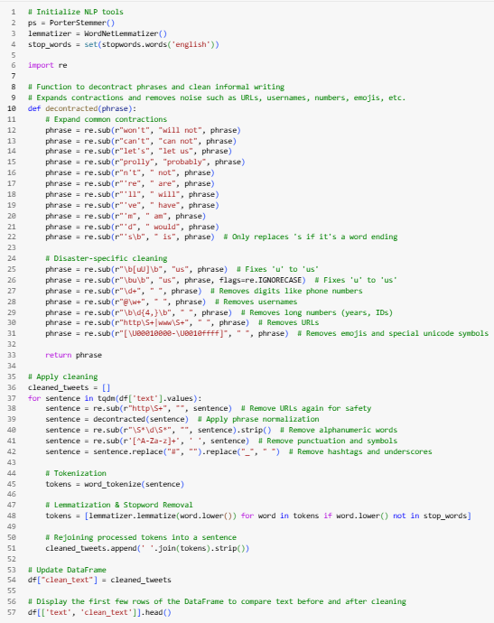
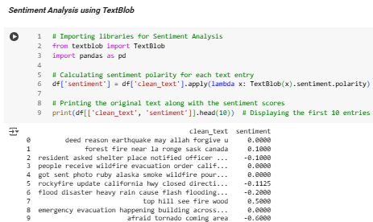
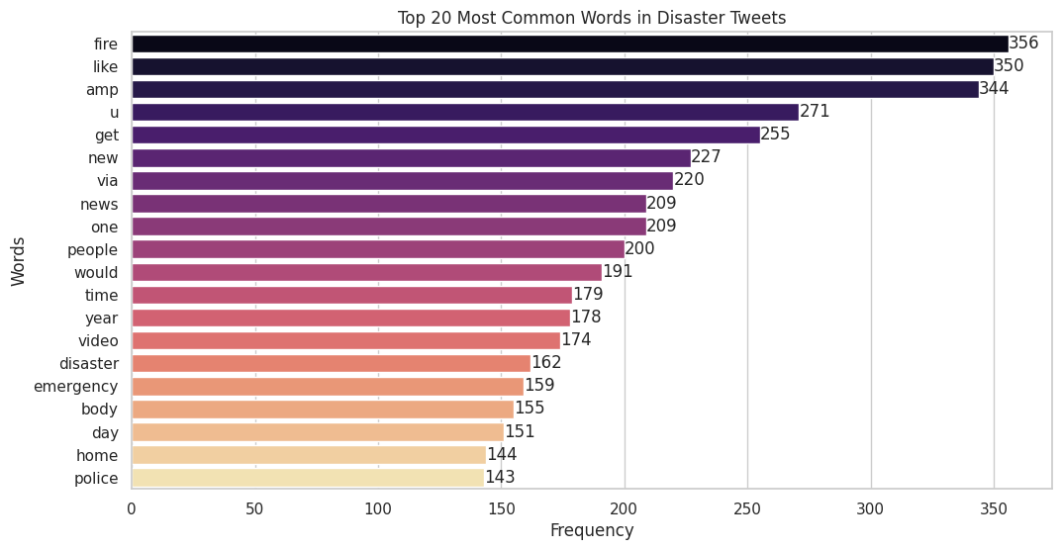
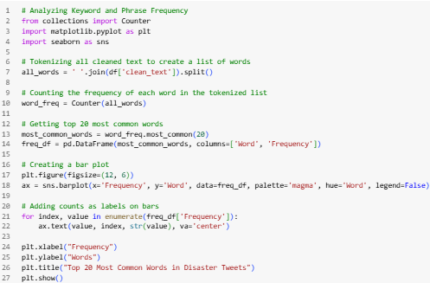
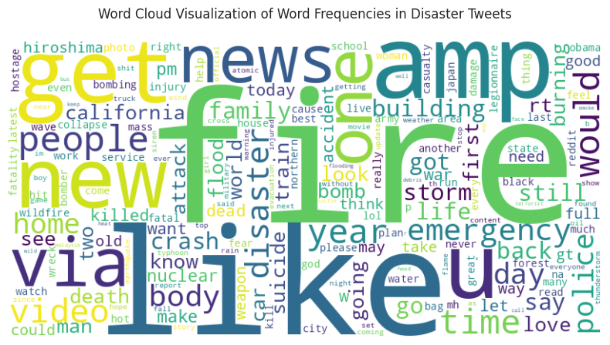
Data Cleaning & Frequency Analysis
Data Preparation & Cleaning
✔️ Removed URLs, special characters, & numbers ✔️ Lowercased 🔡 | Tokenized 🔤 | Lemmatized 📚 ✔️ Removed boring stopwords 🗑️ 🎯 Outcome: Clean, sharp text with only the good stuff left!
01
Sentiment Analysis
🧠 Used TextBlob to score each tweet’s emotional tone
📈 Polarity score from -1 (negative) to +1 (positive)
🗂️ Added a new sentiment column
✨ Helps the model understand feelings, not just words!
02
Keyword Frequency Analysis
📦 Tokenized + Lemmatized + Counted via `Counter()`
🏆 Top Words:
🐦‍🔥 fire" (356), "like" (350), "amp" (333), "get" (255), "new" (227)
🔥 Disaster words like “emergency,” “disaster,” “fire” dominate!
03
Word Cloud Visualization
🖼️ Built a Word Cloud from tokenized words
🔠 Bigger words = More mentions
🚨 Spotlight on: "fire," "emergency," "disaster," "police," "news“
📌 Confirms the theme: Disaster-Focused Tweets
04

Slide 5
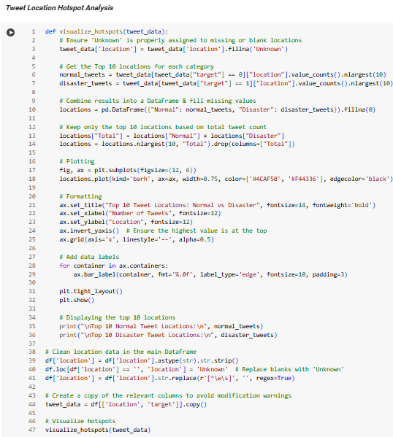
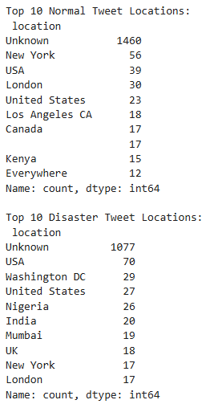
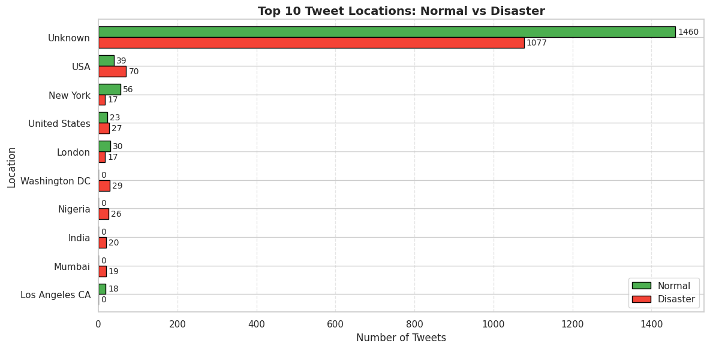
🌍 Tweet Location Analysis
📍 “Unknown” Rules the Map
1
🕵️‍♂️ Most tweets have no location data 🔸 1460 Normal | 1077 Disaster tweets = “Unknown” 📉 Shows a huge gap in geotagging on Twitter
🇺🇸 USA: Top Disaster Tweeter (Excl. Unknown)
2
🌪️ 70 Disaster Tweets vs. 39 Normal from the USA 🧭 Suggests stronger disaster awareness, reporting, or tagging in the U.S.
🗽New York Talks, But Not About Disasters
3
🗨️ 56 Normal Tweets vs. only 17 Disaster Tweets ⚖️ High general activity, but fewer tweets tagged as disasters
🌐 Disaster-Only Locations Appear
4
📍 Nigeria, India, UK, Washington DC, Mumbai 🚨 These regions only pop up during disasters, not in normal tweeting
📣 Global South: Loud in Crisis
5
🌏 Countries like India & Nigeria show up in disasters 📢 May reflect higher alertness or public concern during emergencies
🌆 Urban West = Normal Tweet Hotspots
6
🗺️ London, NYC, LA, Canada lead normal tweeting 💡 Suggests routine Twitter use is higher in urban, developed regions
🏛️Washington DC: All About Disaster
7
📊 29 Disaster Tweets | 0 Normal Tweets 📡 Possibly due to news media, alerts, or official comms

Slide 6
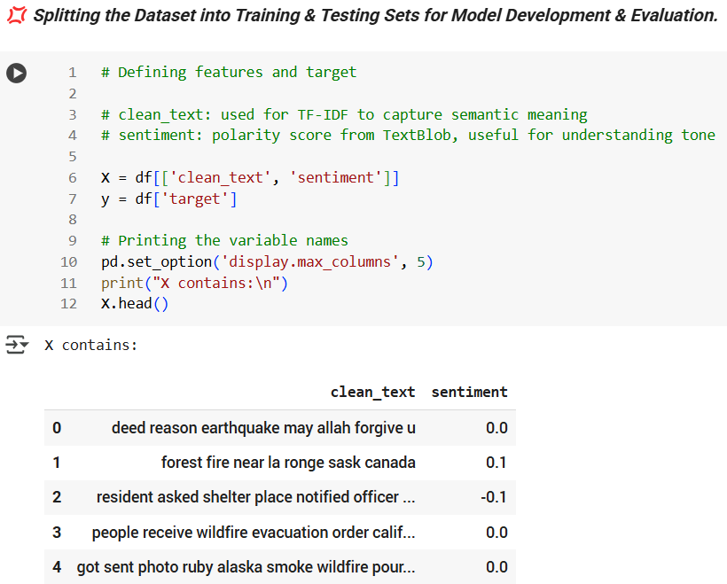
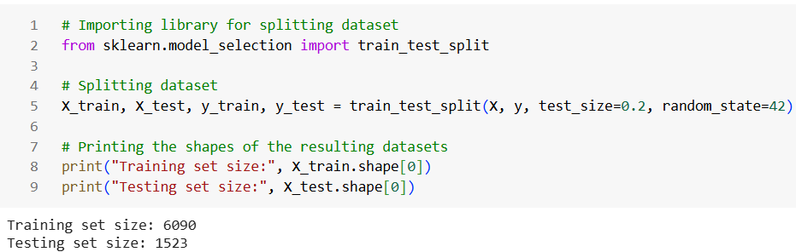
💢 Splitting the Dataset into Training & Testing Sets for Model Development & Evaluation
🧠 Feature Setup
1
Features (X) include:
✅ Cleaned Tweets 🧹
✅ Sentiment Scores from TextBlob
💬Together, they form a rich dataset of 7613 entries
➕ Sentiment adds emotional context to raw text!
🎯 Target Variable
2
y holds the binary labels:
1 → Disaster Tweet 🚨
0 → Normal Tweet 🕊️
A clean and simple setup for supervised learning!
✂️ Train-Test Split Summary
Used an 80/20 ratio for training and testing:
🧪 Training set: 6090 entries
🧪 Testing set: 1523 entries
Ensures the model learns well and is tested fairly
3
📌 Bottom Line
✅ The dataset is now model-ready, complete with smart
Features & clear labels
✅ Split cleanly to enable robust model development &
accurate evaluation 🚀📊
4

Slide 7
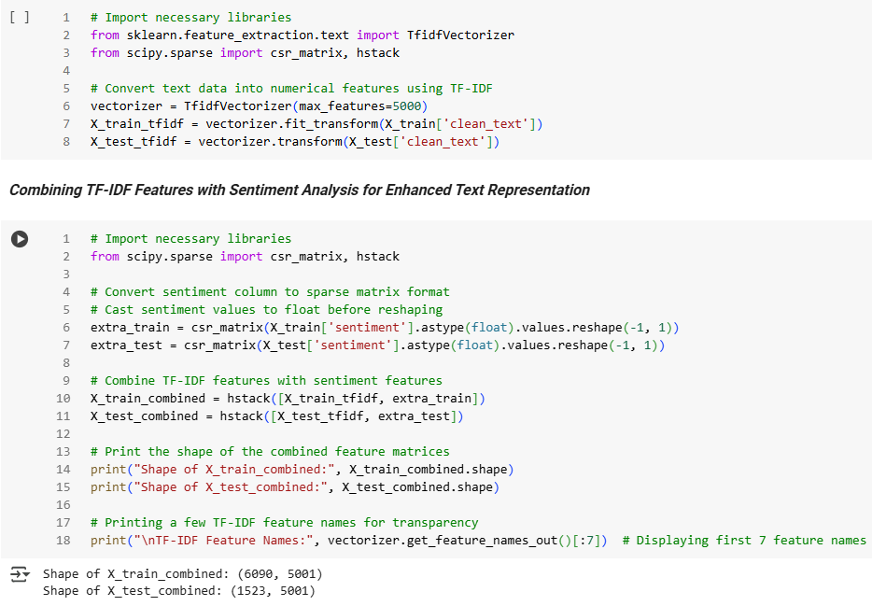


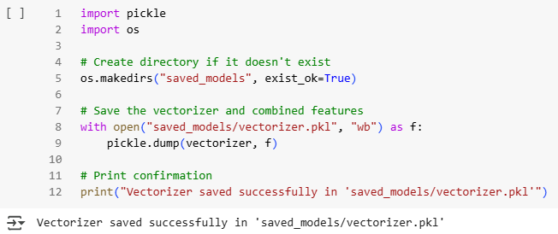
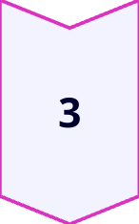
TF-IDF & Sentiment-Based
Feature Engineering & Class Balancing
🧾 TF-IDF Vectorization
Cleaned tweets transformed into numerical vectors using TfidfVectorizer
🔢 Feature cap set to 5000 to maintain balance
📏 Matrix sizes:
Training → (6090, 5000)
Testing → (1523, 5000)
🧪 Printed sample features like 'aa', 'ab', 'aba' for transparency
💾 Vectorizer saved in saved_models/ for reuse
💬 Sentiment Added as a Feature
Used TextBlob polarity to score tweet tone
➕ Converted sentiment column into a sparse matrix
🔗 Merged with TF-IDF vectors
Gives tweets an emotional dimension — not just text!
📌 Takeaway
A powerful combination of semantic (TF-IDF) and emotional (sentiment)
features enhances the model's understanding of tweet content. 🔍📊

Slide 8
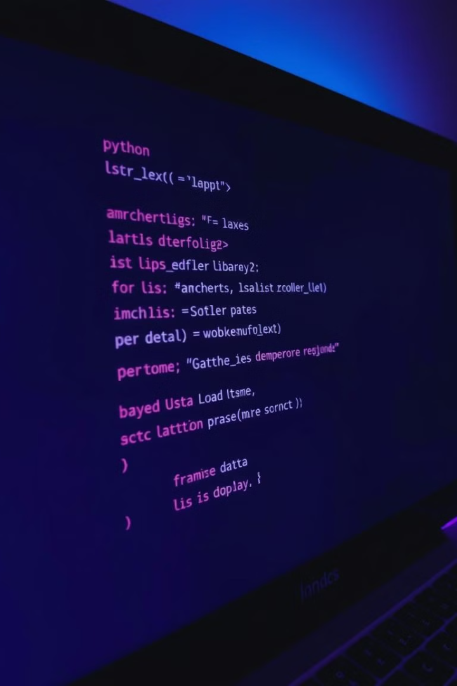
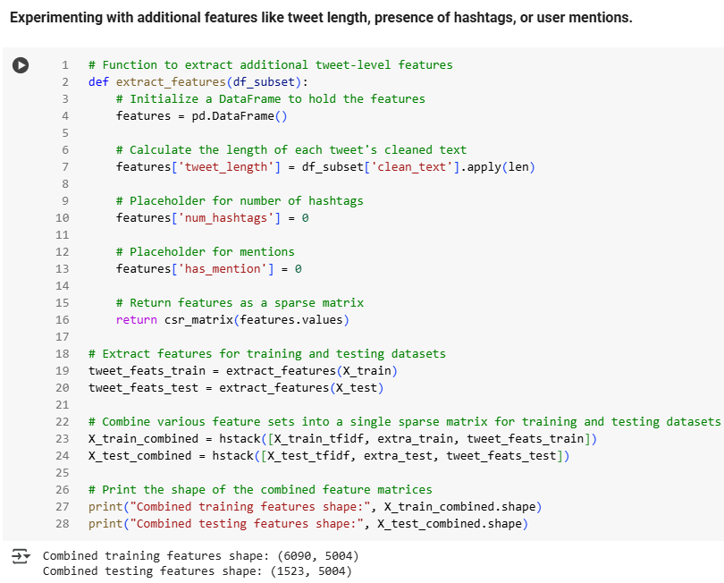
Tweet-Level Features & Final Feature Matrix
🛠️ Extra Tweet-Level Features
1
Extracted tweet length as a numeric feature
Added placeholders for:
🔢 Number of hashtags
🔗 Number of mentions
These help provide context beyond words
🧩 Combining It All: One Unified Feature Set
2
Final matrix combines:
✅ TF-IDF vectors: Max 5000 features
✅ Sentiment scores: Emotional Tone alongside raw text content
✅ Tweet-level features: ✅ Tweet length, #️⃣ Hashtags & 👥 Mentions
🧮 All merged into a single sparse matrix — compact, efficient,
and information-rich
⚠️ The Problem
3
📉 Original Dataset Was Imbalanced:
🕊️ Normal Tweets (Class 0): 3468
🚨 Disaster Tweets (Class 1): 2622
⚠️ Risk: Model might favour the majority class, leading to skewed predictions and lower performance on disaster detection.
🔁 The Fix — SMOTE
3
🧪 Balanced the dataset by synthetically generating new disaster tweet samples to match the majority class.
📊 Post-SMOTE Class Counts:
✅ Class 0 (Normal): 3468
✅ Class 1 (Disaster): 3468
🎯 This ensures fairer learning and reduces model bias toward the majority class.

Slide 9
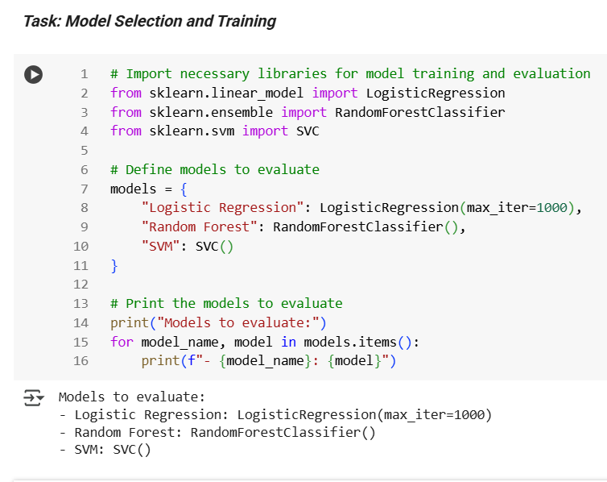
Selecting the Right Model
⚙️ Models Explored for Training:
STEP
01
To identify the best fit, I tested these three powerful classifiers:
✅ Logistic Regression
🌲 Random Forest
📈 Support Vector Machine (SVM)
All models were initialized with basic parameters & verified for correct setup. 🛠️🧪
🧠 Logistic Regression:
STEP
02
✅ Set max_iter =1000 to ensure smooth convergence
✅ Extremely efficient with TF-IDF and added features
✅ Quick, accurate, and reliable
🌲 Random Forest
STEP
03
☑️ Great at handling complex feature sets
🐦‍🔥 Should perform decently but is a bit resource-intensive & slower
🦋 Best used when interpretability isn't a top priority
📈 SVM
STEP
04
💪🏻 Known for strong performance in text classification
⏳ Required more time and hyperparameter tuning
🤷🏻‍♂️ Less practical here due to slower training time

Slide 10
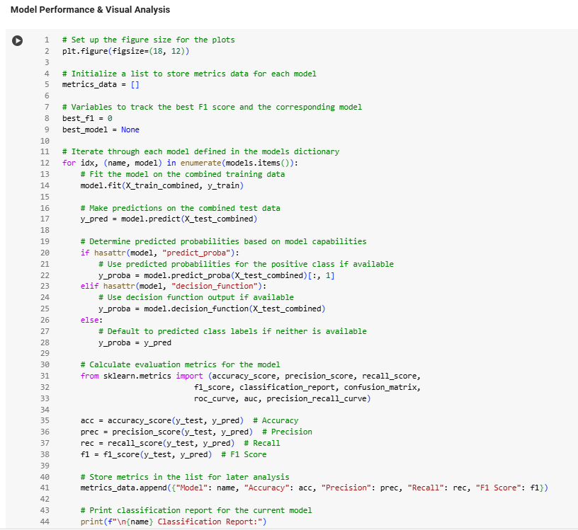
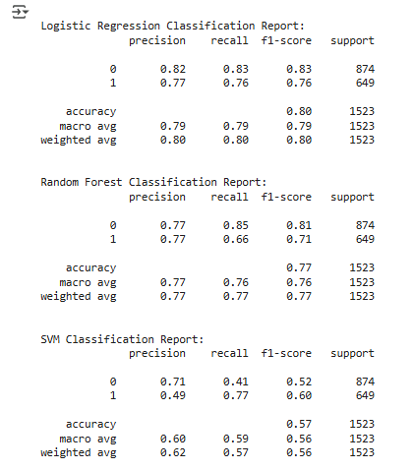
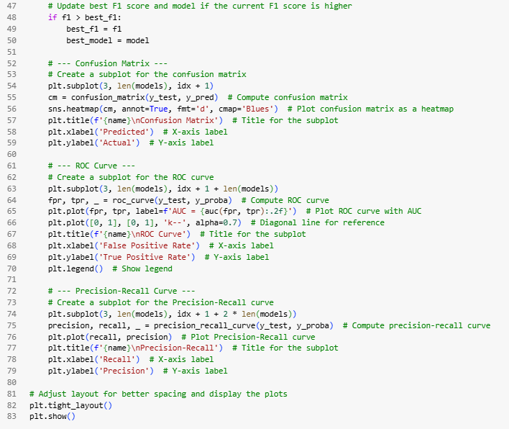
Model Performance – Metrics at a Glance
01
1️⃣ Logistic Regression Leads with Consistency
✅ Accuracy: ~80%
✅ F1 Score: ~0.80
✅ ROC AUC: ~0.86
✅ Precision-Recall: High & Stable
02
2️⃣ Random Forest Delivers Competitive Results
✅ Accuracy: ~77%
✅ F1 Score: ~0.77
✅ ROC AUC: ~0.84
⚠️ Slightly more misclassifications for disaster tweets
03
3️⃣ SVM Falls Short for This Problem
❌ Accuracy: ~57%
❌ F1 Score: ~0.56
❌ ROC AUC: ~0.63
❌ Precision-Recall curve drops sharply

Slide 11
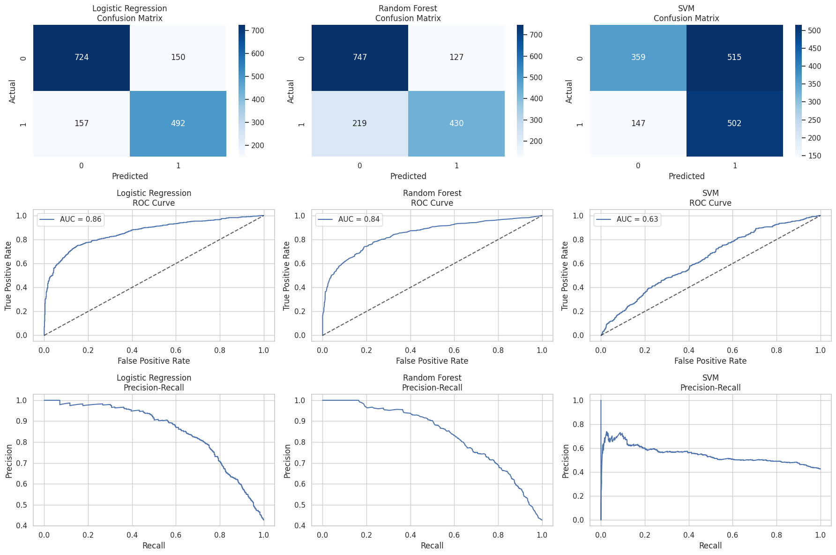
Visual Evaluation – What the Charts Say
✅ Confusion Matrices:
📈 ROC Curves:
📉 Precision-Recall Curves:
Logistic Regression: Strong diagonals, better class distinction
SVM: Lighter matrix, more errors & confusion
Logistic Regression:
Tops with AUC ~0.86
Random Forest:
Close second with AUC ~0.84
SVM:
Lowest, AUC ~0.63
Logistic Regression:
High precision across recalls
Random Forest:
Steady, but dips slightly
SVM:
Sharp drop, lower overall precision

Slide 12
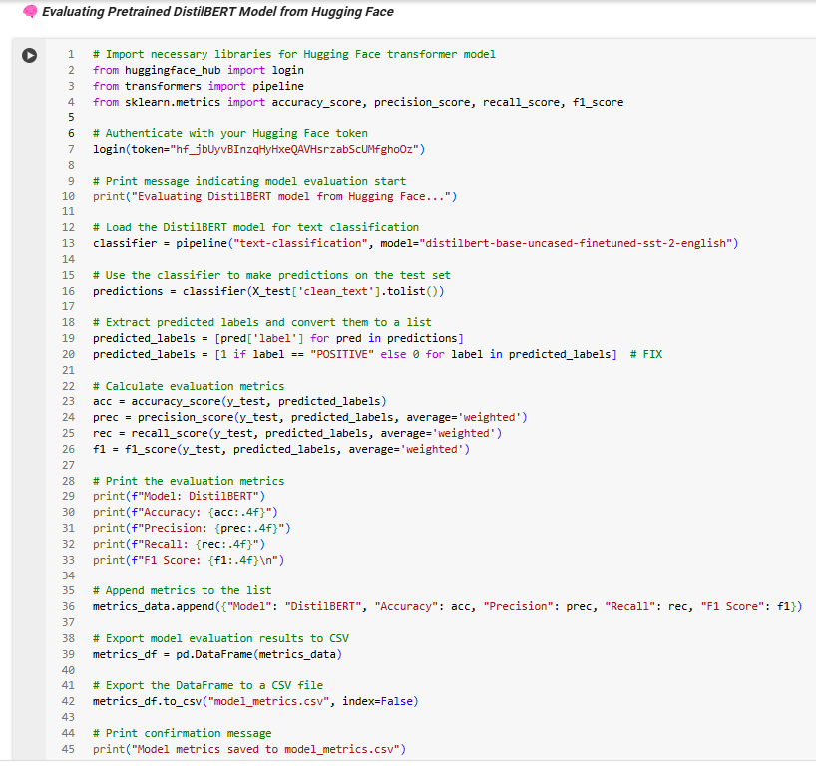
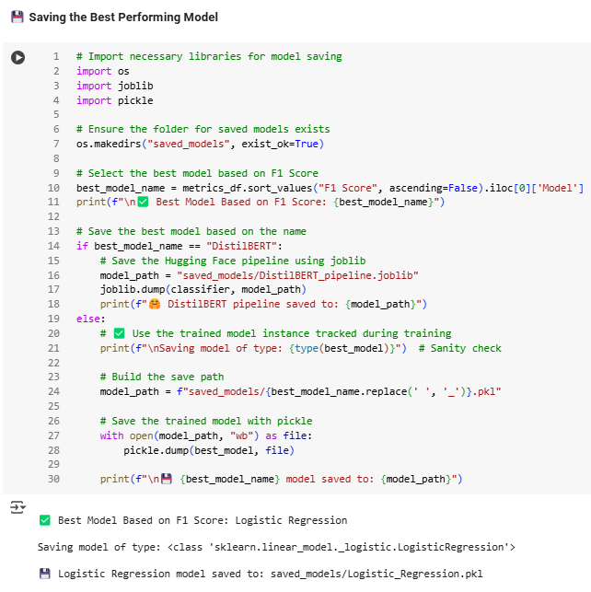
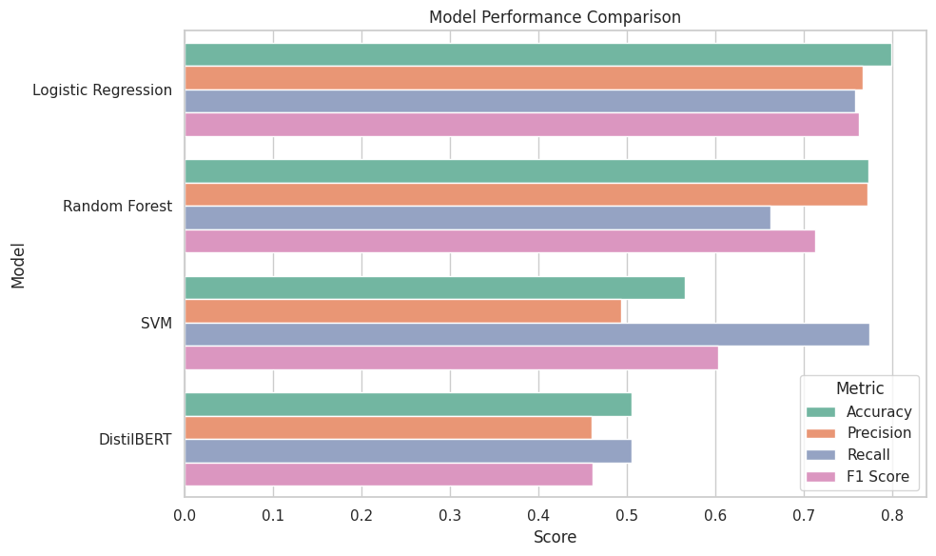
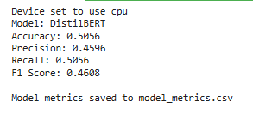
Model Comparison & Best Model Determination & Auto-Saving
🔍 Custom Models vs. DistilBERT
I compared my tailored models (Logistic Regression, Random Forest, SVM) against the pretrained DistilBERT 🤖 from Hugging Face.
📊 Custom Model F1 Score: ~0.80
😕 DistilBERT F1 Score: ~0.46 (no fine-tuning)
Visuals (Confusion Matrix, ROC, Precision-Recall) clearly favoured the custom setup 💡
01
🏆 Best Model Determination & Saving 💾
✅ The Custom Model emerged as the top performer 🏆
📊 Logged performance metrics in model_metrics.csv 📈
💾 Saved the best model in the saved_models directory using pickle 🔐
02
📌 Bottom Line
🧠 A domain-tuned model outperformed a generic transformer 🤖
🚀 The best model is stored & good to go for deployment ✅🎯
03

Slide 13
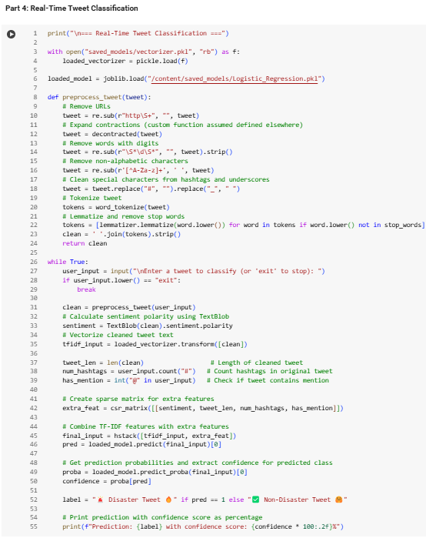
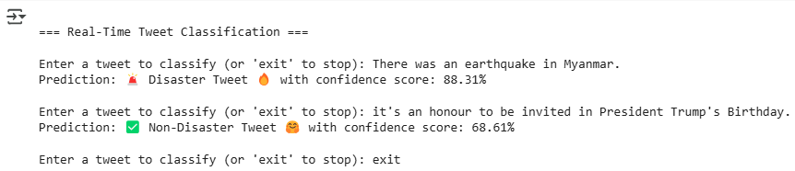
Real-Time Tweet Classification Performance
01
📌 Live Testing with User-Entered Tweets
🚀 Ran the model on fresh, unseen tweets to check real-world performance.
🌋 Tweet: "There was an earthquake in Myanmar" → Predicted as
🚨 Disaster Tweet with 84.05% confidence.
🎉 Tweet: "it's an honour to be invited in President Trump's Birthday" → Predicted as
✅ Non-Disaster Tweet with 73.86% confidence.
02
🧠 Boosted Accuracy with Rich Features
🧩 I enriched the classification by combining TF-IDF vectors with smart features like:
🧾 Tweet length
❤️ Sentiment score
🔢 Hashtag count
👤 Mentions (@) presence
⚡ Results
03
03
Fast, consistent, and reliable predictions ✅
Acted as a mini deployment simulation, showing strong performance outside the test set 🔍
The model confidently handles real-world inputs — it's not just trained, it's ready to serve
insights on live data! 🎯📲

Slide 14
🚀 Disaster Tweet Detector — Streamlit App Overview
🔗 Live App: Disaster Tweet Detector 🚨🧠
🎥 All About My Streamlit App: Click to Watch (CTRL + Click)▶️
🌪️ Disaster Tweet Detector
📊 Tweet Analysis
STEP
01
STEP
06
Extra insights like sentiment, length, hashtag count, mentions, and emoji use 🧠.
Built a clean, easy-to-use app to classify tweets as 🚨 Disaster or ✅ Non-Disaster.
✍️ Live Input or Example Tweets
⬇️ Download Prediction
STEP
02
STEP
07
Enter your own tweet or click an example to auto-fill instantly 🚀.
Segmented session durations into deciles, revealing patterns in data usage.
🔍 Predict Button
⚡ Fast & Smooth UX
STEP
03
STEP
08
One click analyzes the tweet, predicts category, shows confidence % and mood 🎯.
Save your tweet analysis as a CSV with just one click 📥.
🧹 Reset All
🤖 Powered By
STEP
04
STEP
09
One click clears results, double click clears tweet input too for a full reset 🧼✨.
Prediction, visualization, and reset all work instantly without weird reloads 🚀.
📈 Confidence Breakdown
🚀 Real-World Ready
STEP
05
Neat pie chart showing prediction probabilities side-by-side 🍰.
STEP
10
Logistic Regression model trained on TF-IDF + smart features like sentiment, length, hashtags, mentions 🔥.
FRE!

Slide 15
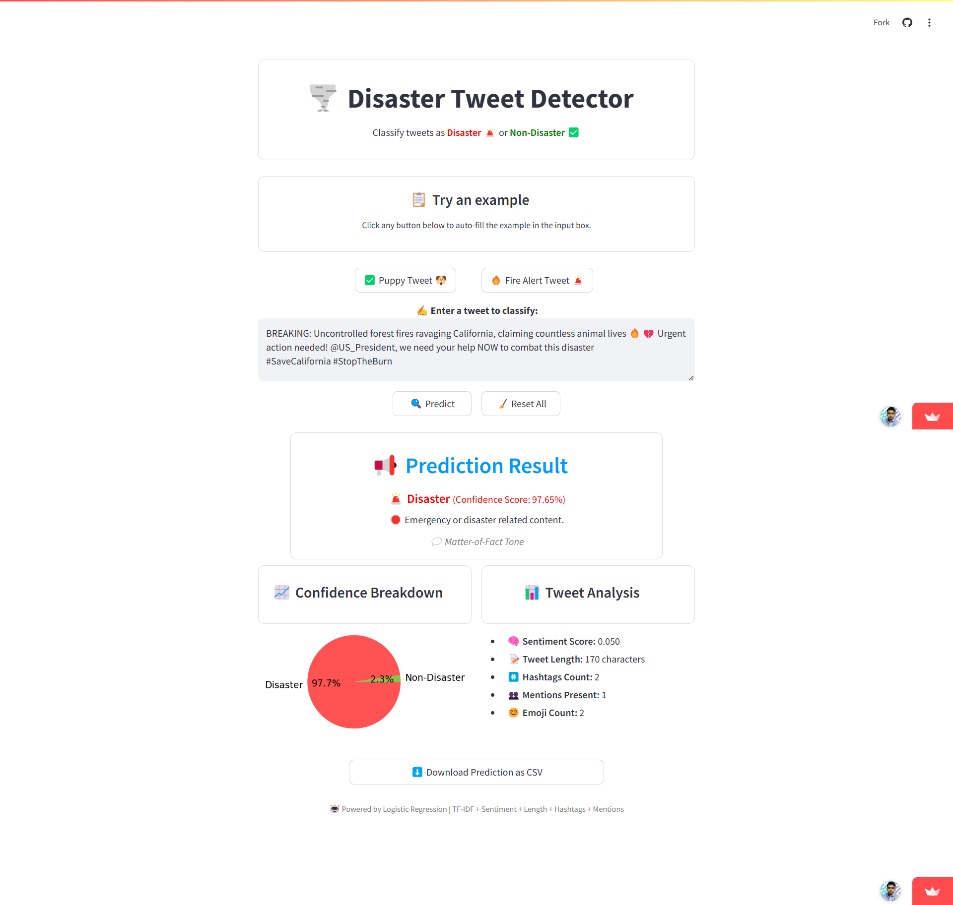
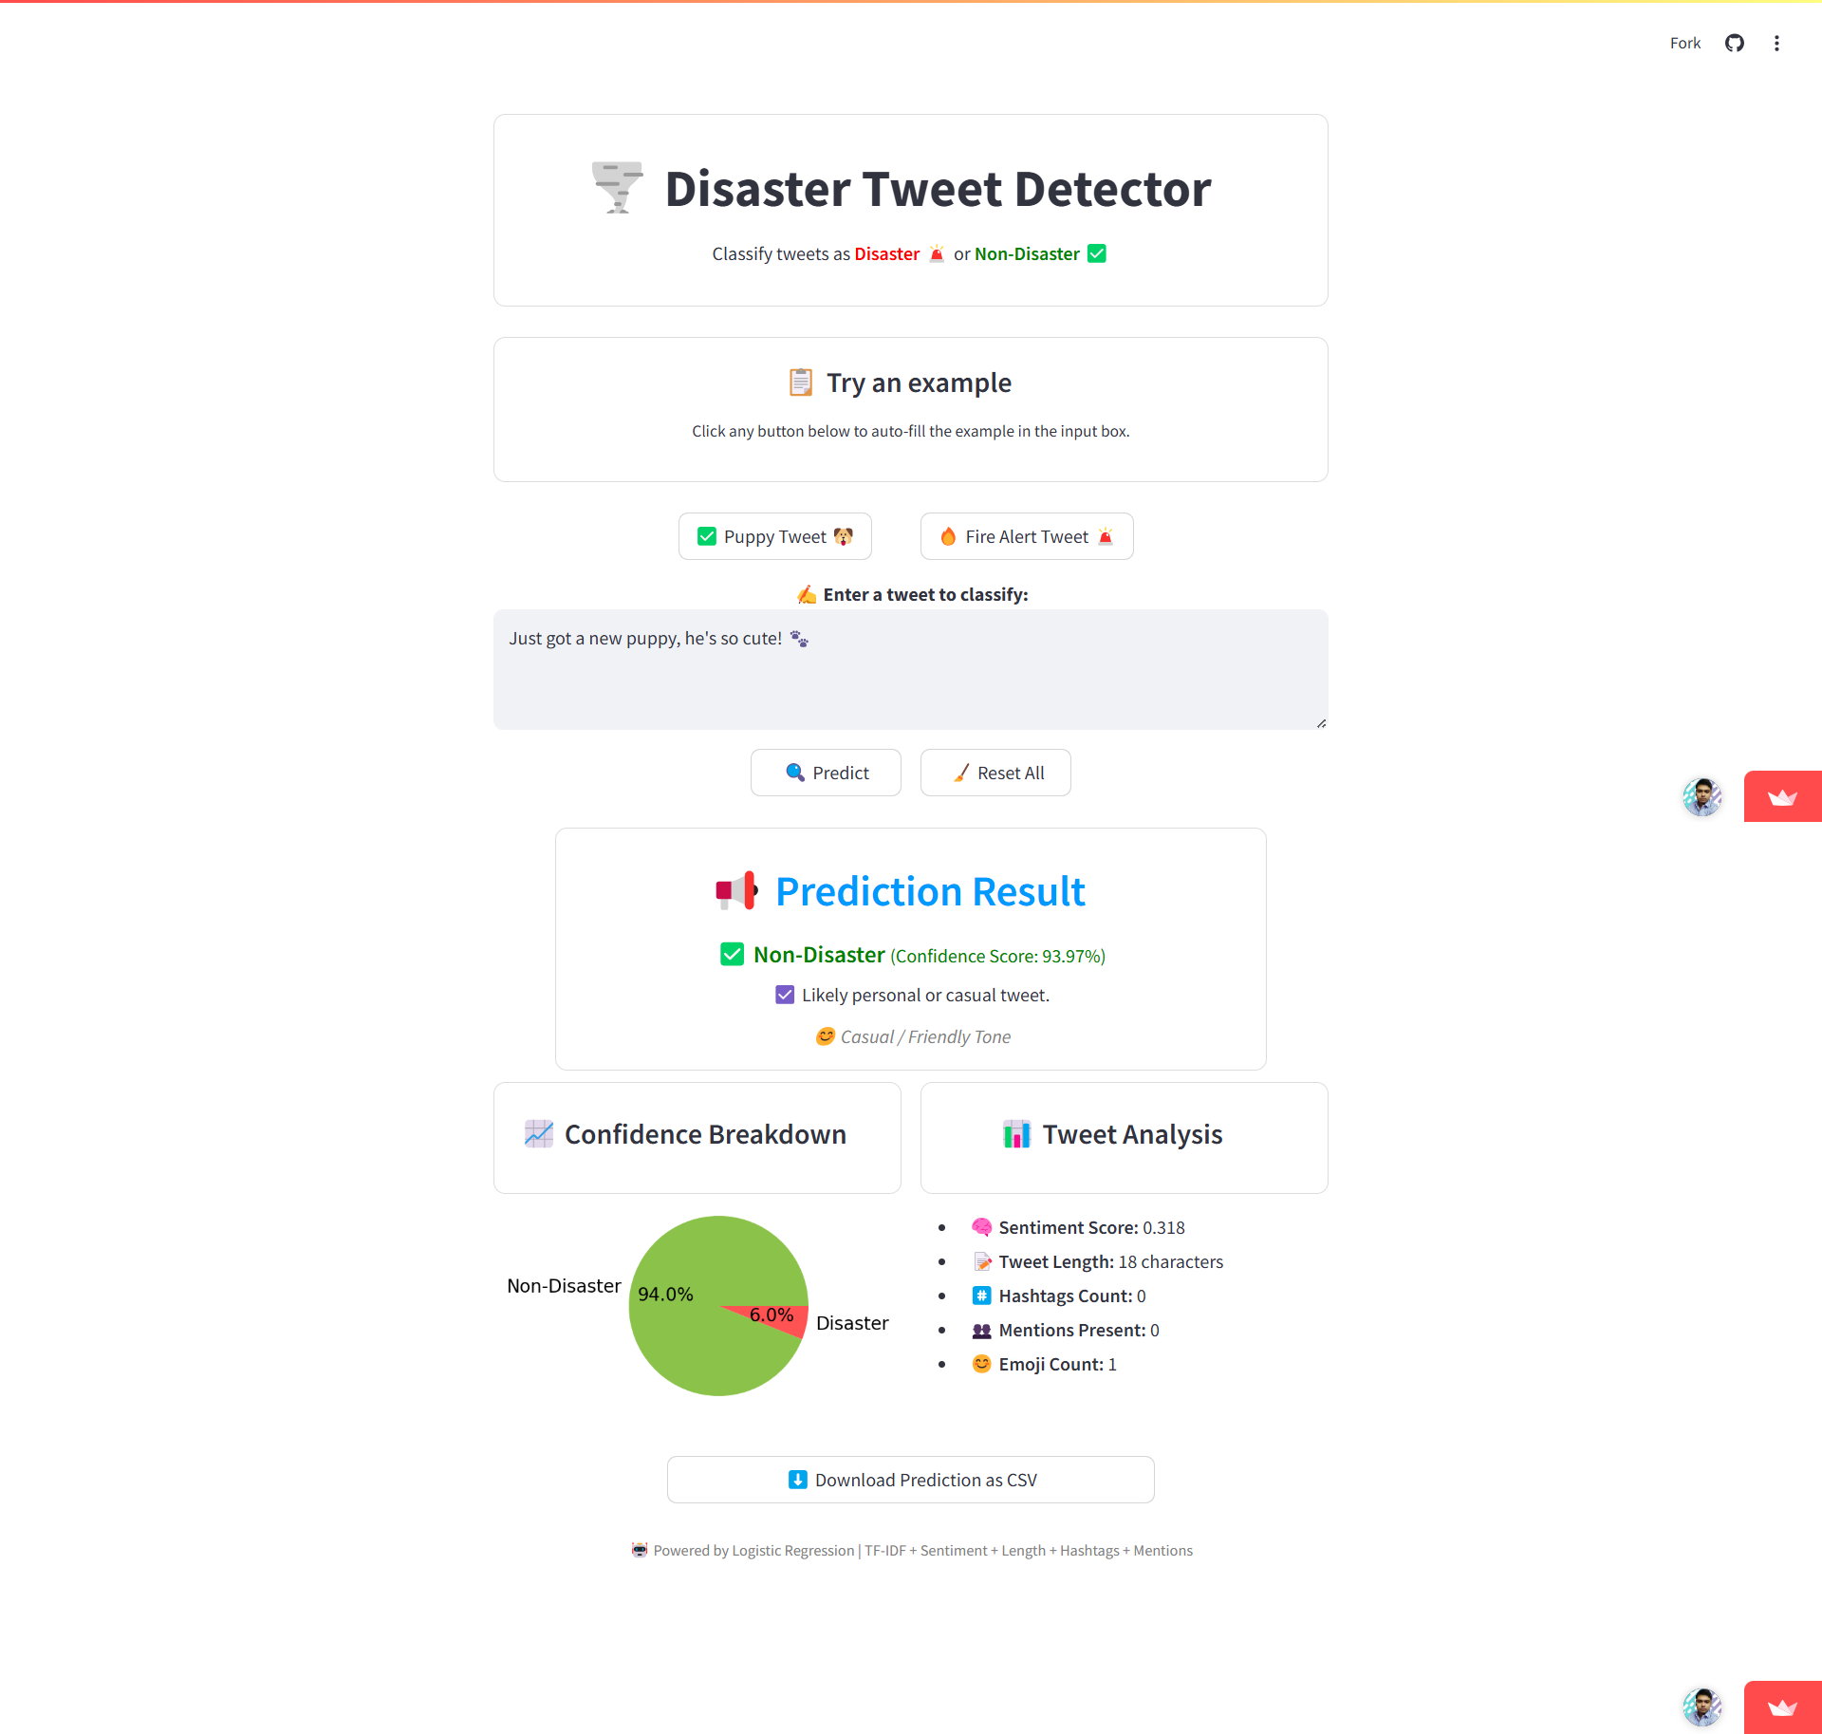
🎨 Sleek & User-Friendly Streamlit Interface for
Real-Time Tweet Analysis
01
🔵 Centralized Layout
Every button, example, & output is thoughtfully center-aligned for a clean, professional look 🎯
02
🟠 Instant Example Loading
Example tweets load immediately into the input box without refreshing the page. ⚡
03
🟣 Consistent Design
Matching boxed sections for prediction, analysis & pie charts keep the UI smooth & intuitive. 🎨
04
Data Insertion
Used a MERGE statement to insert or update user scores based on the existing records in the table.

Slide 16
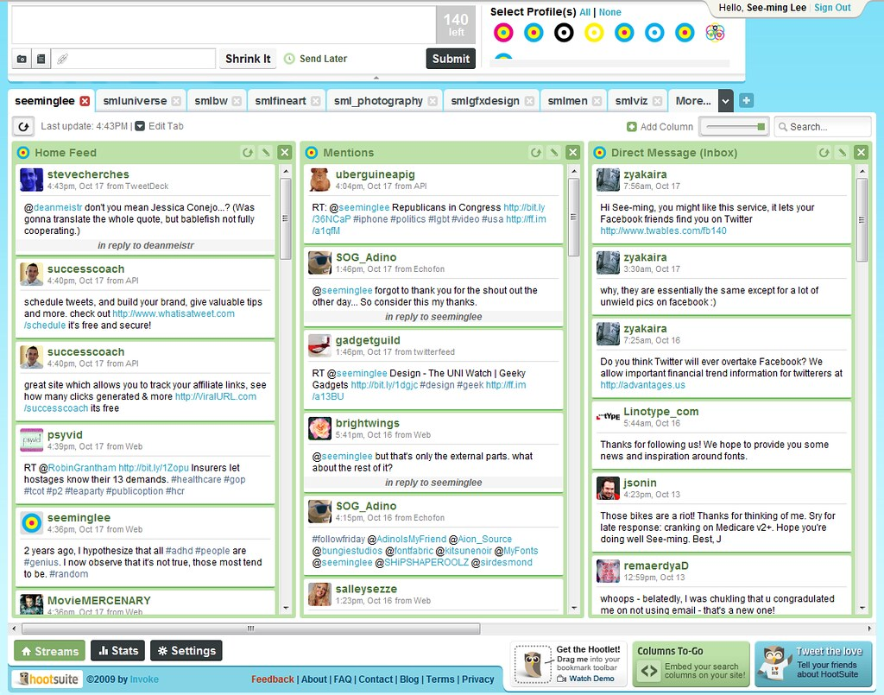
THANK YOU
I appreciate your time and attention & hope this presentation was informative and helpful.
For any questions or further assistance, please feel free to reach out.
Notes:
Links:
https://unsplash.com/photos/SYTO3xs06fU

